Slide 1
CST For Unilateral Magnet & RF Probe Simulation
Devin Morin
August 6, 2020

Slide 2
Introduction
Using CST (computer simulation technology) to simulate and optimize magnet arrays for a new unilateral magnet.
One can optimize for a parameter and achieve an optimal result.
Using CST to simulate surface current effects on B1 magnetic field.
Notes:
So I’d like to talk about what I’ve been working on so far this summer. I’ve been focused on designing and simulating unilateral magnets, as well as RF probes in a program called Computer Simulation Technology Studio (or CST). This program is wonderful in many ways and can do many things, but I will be discussing this program in the context of magnetostatics, and RF simulation. This program has a lot of functionality to do some really cool stuff, and I’m certain that I’ve only grazed the surface of what it can achieve. But hopefully by showing off all the stuff I’ve been working on with CST, it peeks the interest of someone who wasn’t already completely aware about the program, and it is able to help you in the future

Slide 3
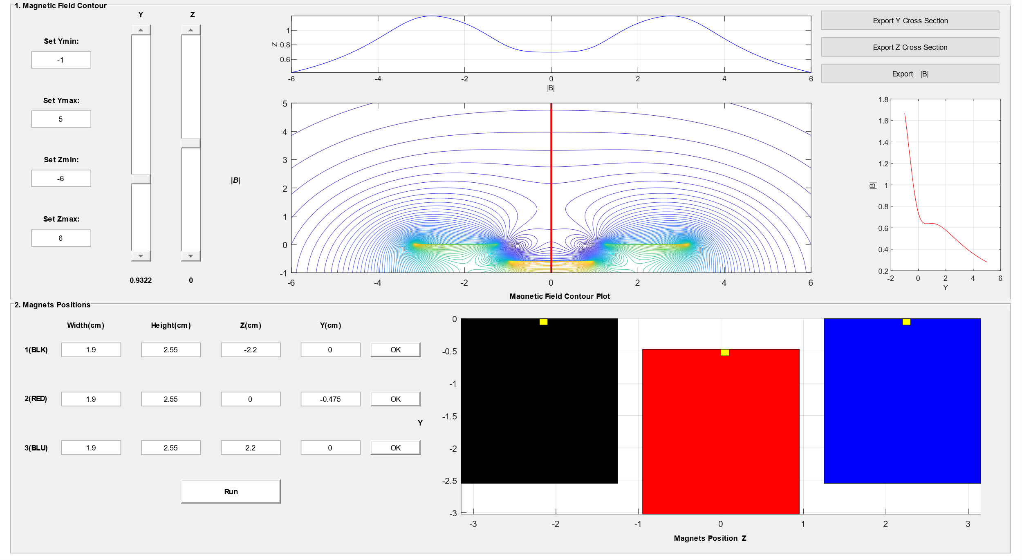
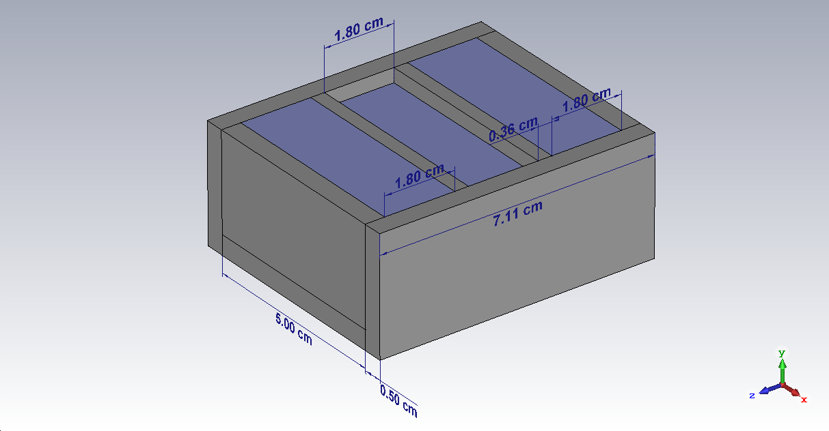
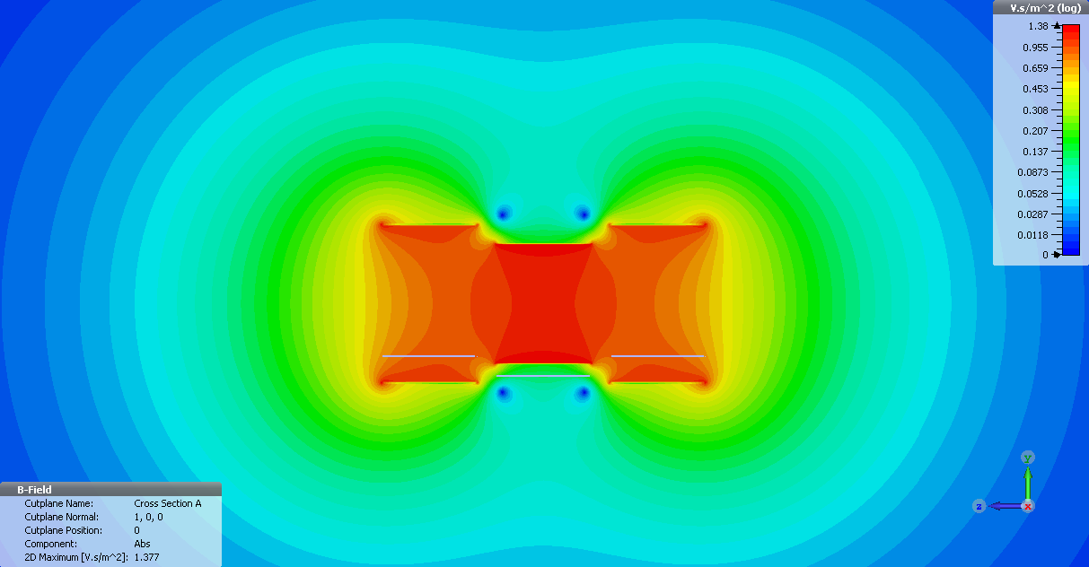
MatLab VS CST
Simple and easy to use
Assumes infinite sheet of current
3D visualization
Built in optimization and force calculations
Proper simulation of fringe fields
Notes:
Now from what I know, we’ve been using Matlab, specifically a program written by Andrew Marble for our unilateral magnet simulations. It is easy to use but is obviously limited in a lot of ways. If you weren’t looking to mess around with parameters to find an optimal result, then you’d have to code in your own optimization algorithm. Fortunately, CST has all of this. You can run an optimization, for example to set a derivative to be zero over a range and produce a homogeneous spot, which is exactly what I’m doing in my case. The MatLab code assumes an infinite sheet of current, which will of course result in an incorrect field strength directly above the magnet. CST, on the other hand produces a realistic magnetic field.

Slide 4
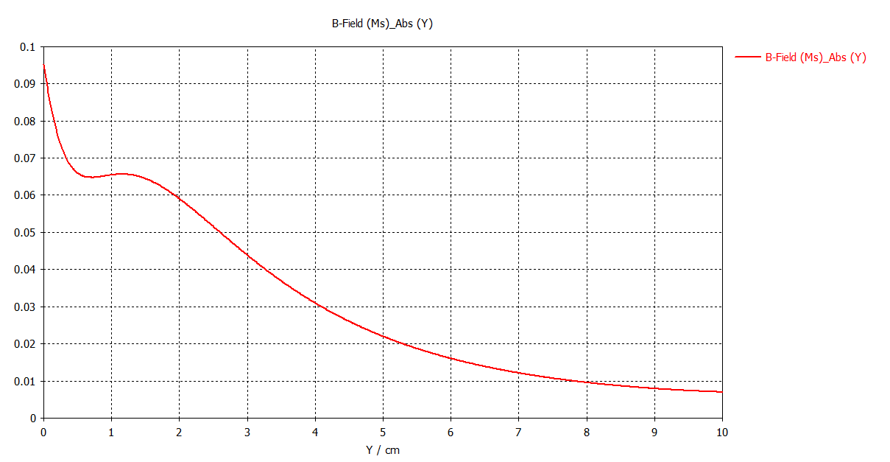
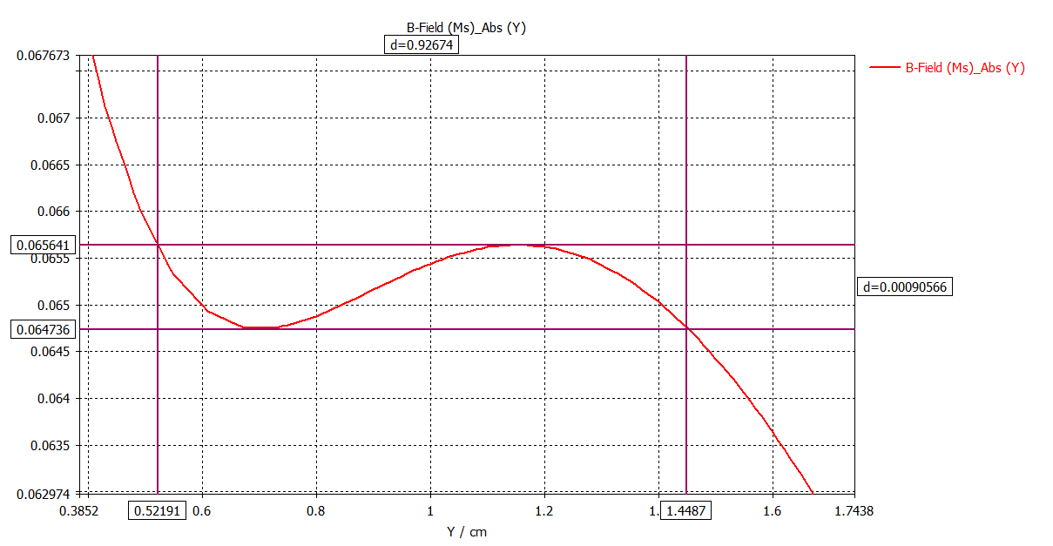
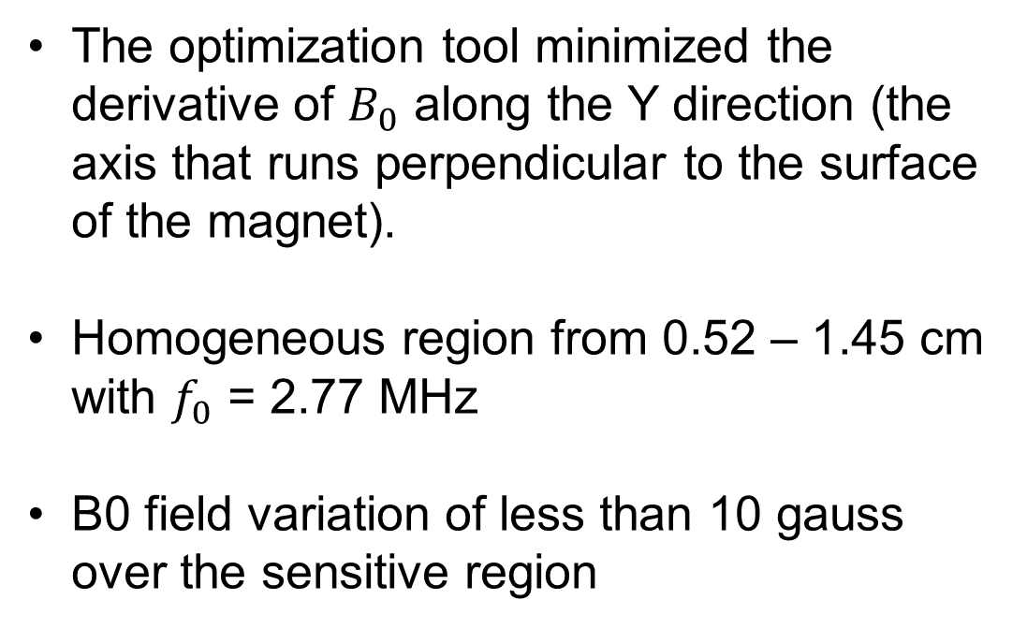
CST Optimization
The optimization tool minimized the derivative of $B_{0}$ along the Y direction (the axis that runs perpendicular to the surface of the magnet).
Homogeneous region from 0.52 – 1.45 cm with $f_{0}$ = 2.77 MHz
B0 field variation of less than 10 gauss over the sensitive region
Notes:
I used the CST optimization tool to produce a homogeneous spot in the Y direction for a 3-magnet array. That is, the line that points perpendicular to the surface, in the exact center of the magnet. In the top right and bottom plots, we can see the magnitude of magnetic field as a function of Y. The top right plots shows the field from 0 – 10 cm, and the bottom right plot shows the magnitude of magnetic field within the sensitive region of the magnet. This magnet has a sensitive spot from 0.52 – 1.45 cm above the surface and contains a magnetic field fluctuation of less than 10 gauss.

Slide 5
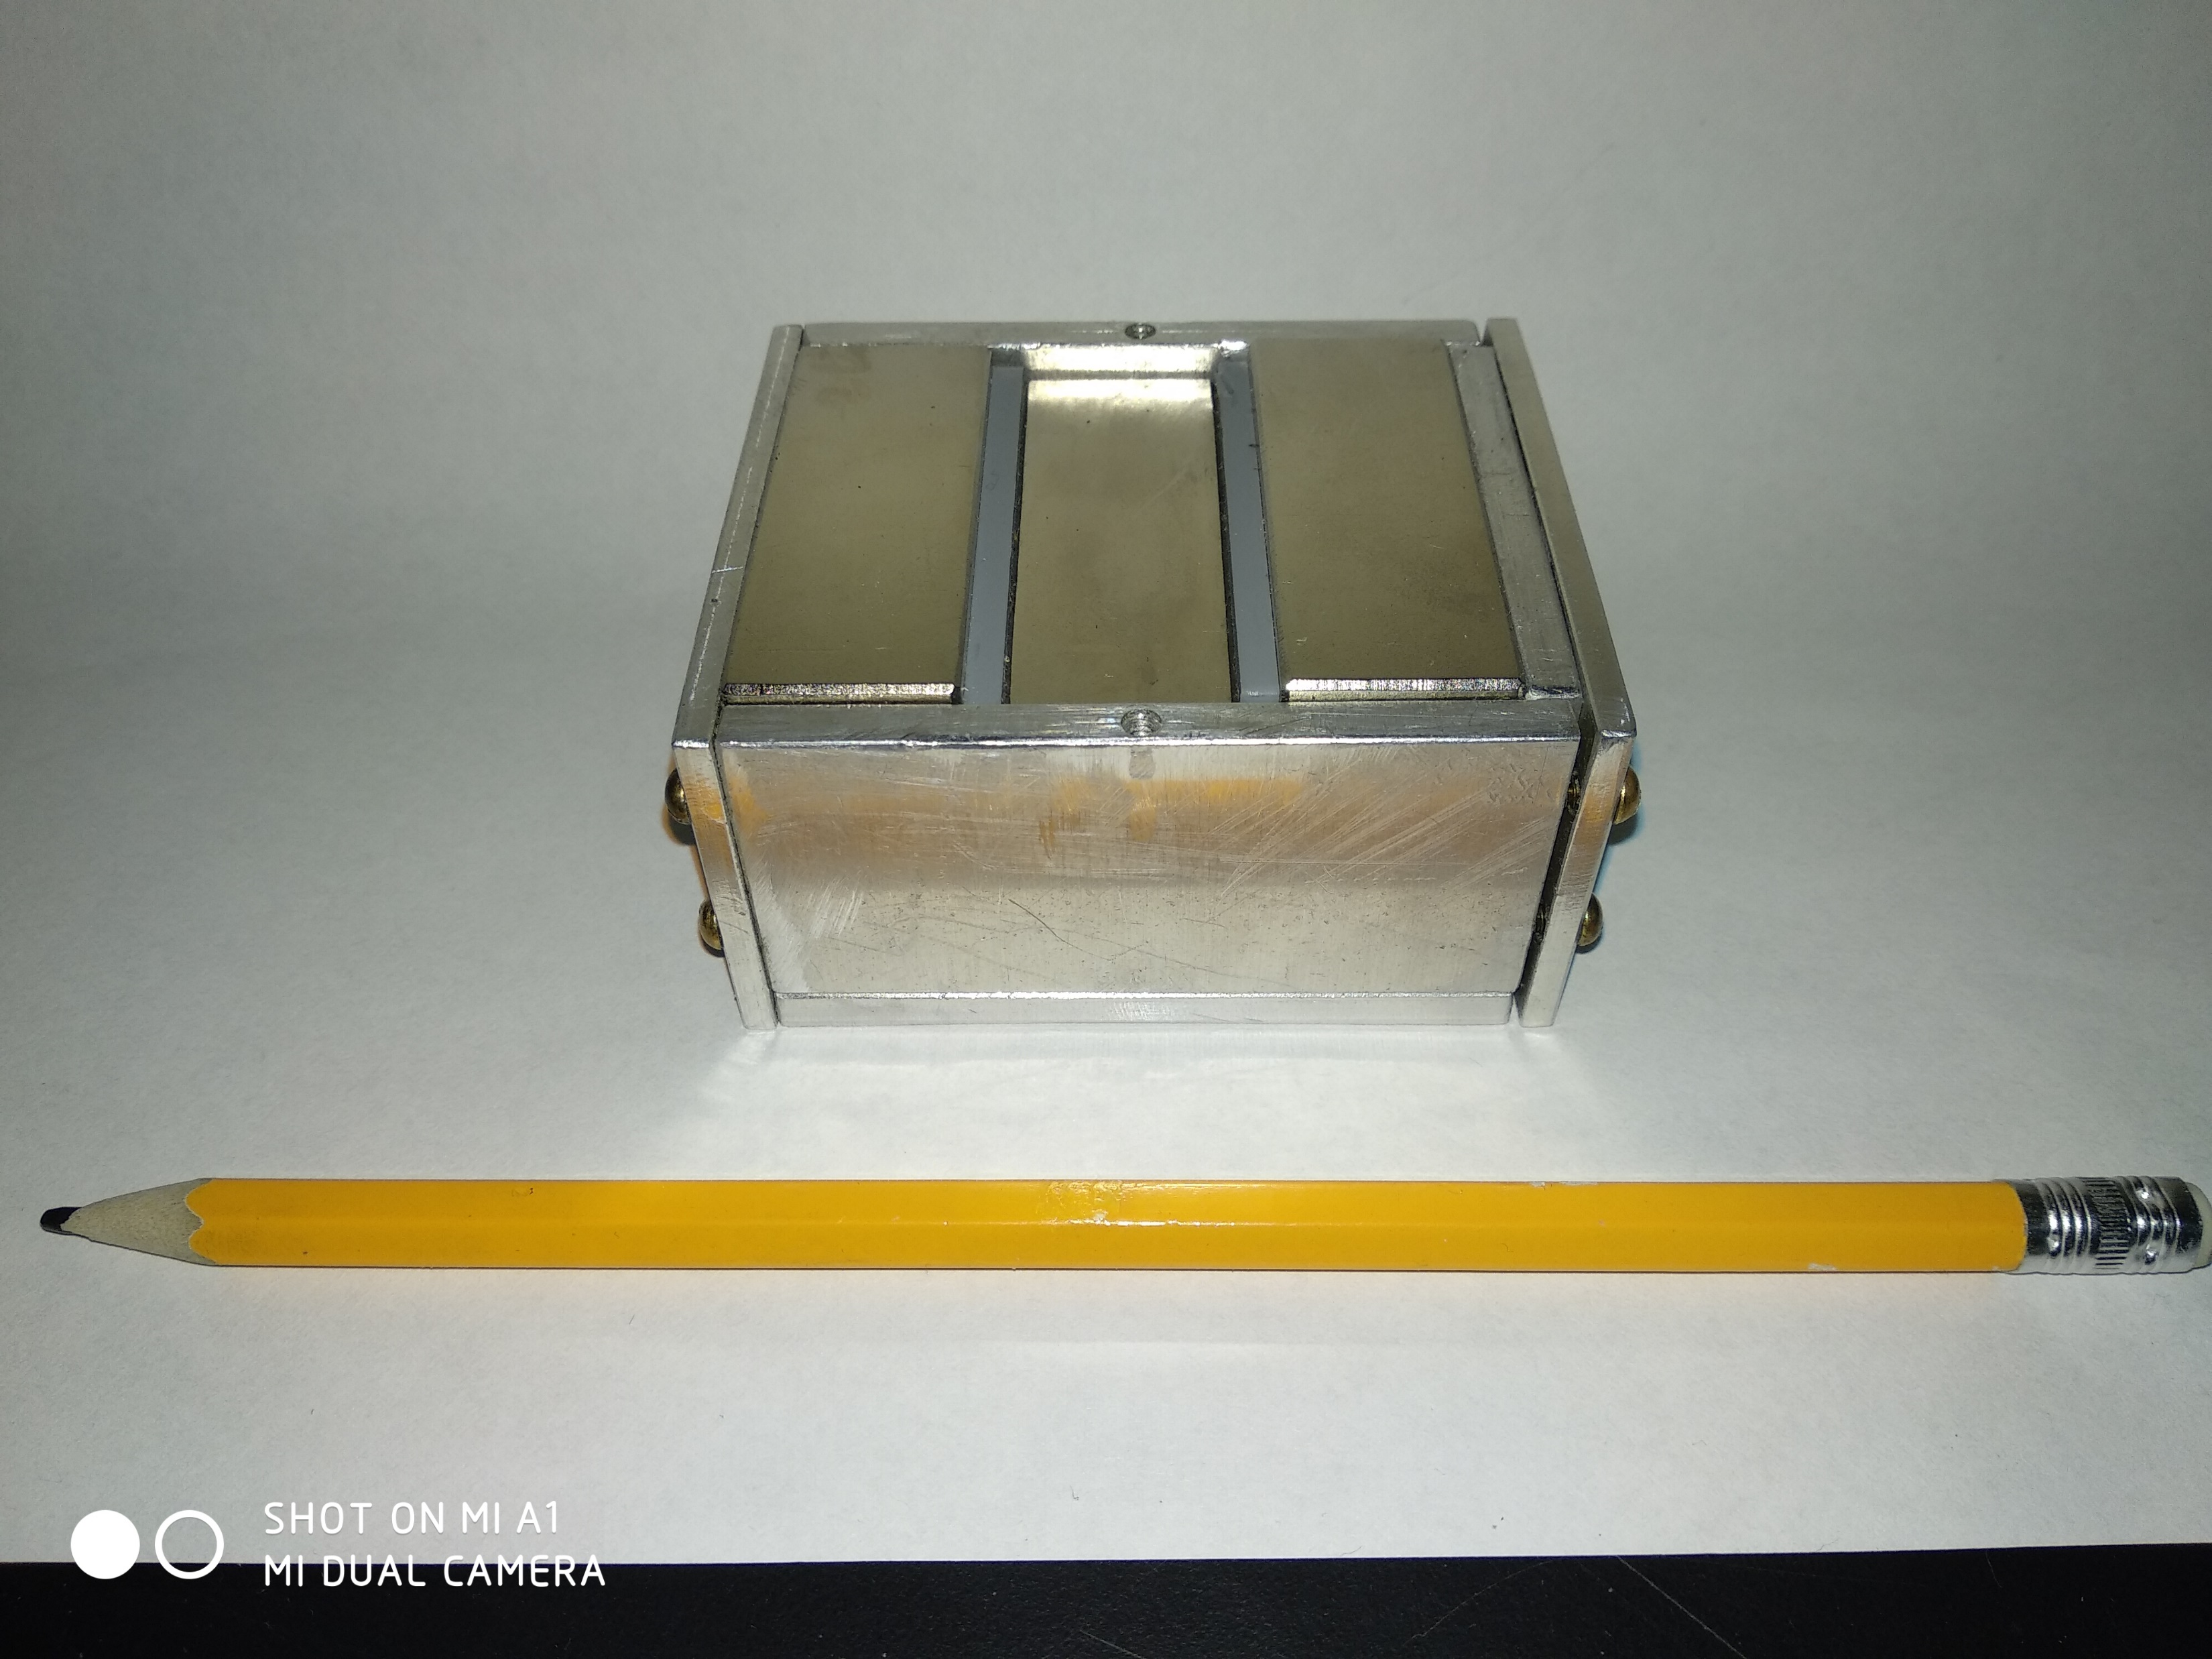
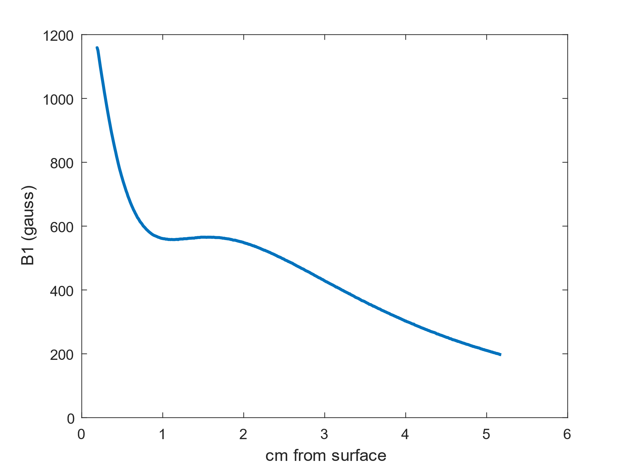
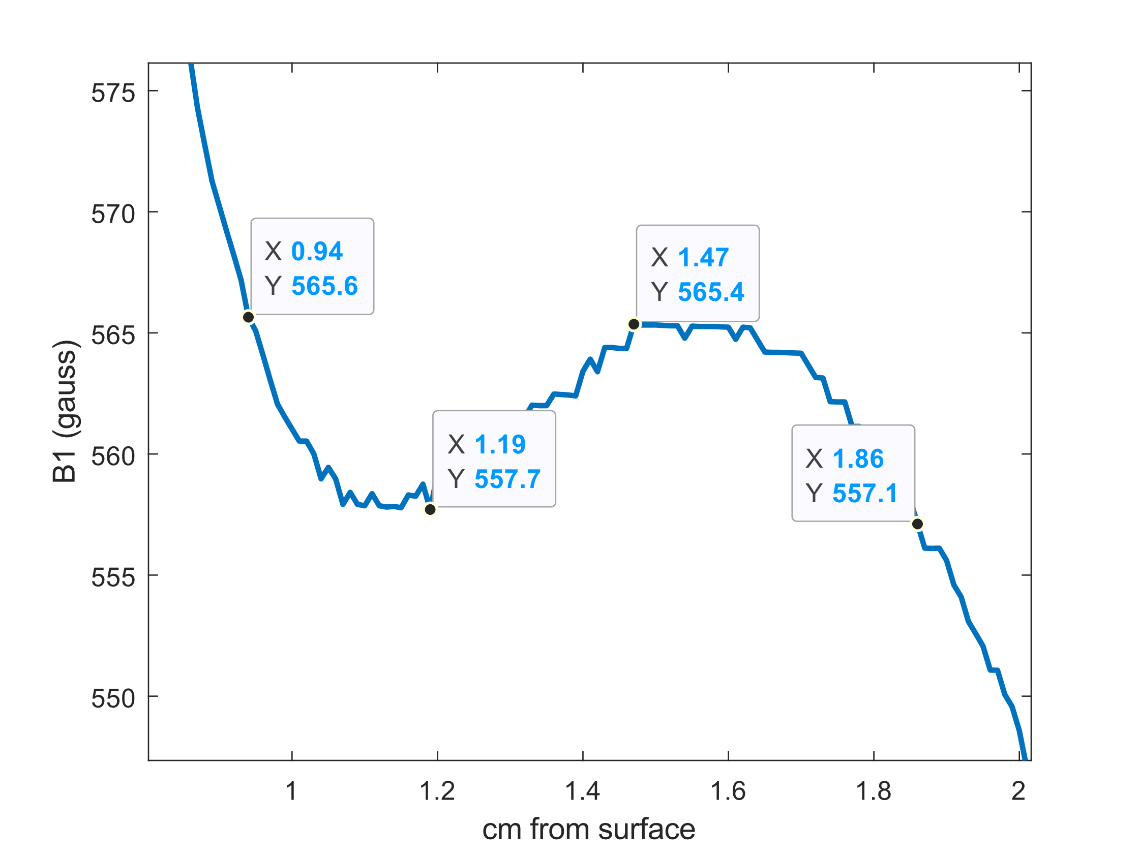
Experimental Results
Sensitive region is shifted
Magnitude of B1 field has decreased compared to simulation
This is maybe due to an incorrect remanence
Sensitive region from 0.94 – 1.86 cm with less than 8 gauss variation.
Notes:
The experimental results were found using the 3D magnetic field plotter. Unfortunately, the results are different compared to what was found in simulation. Based on my experience so far, I believe that it was a combination of many slight differences between simulation and reality. Magnets being slightly larger than what was stated in the inventory, and perhaps magnet remanence being off as well. Nevertheless, it is still exciting. The magnet has a sensitive spot between 0.94 – 1.86 cm above the surface with a magnetic field variation of less than 8 gauss, which is quite low. The field strength is acceptable and compared to many of the other handheld magnets found in the lab. The important aspect of this magnet is the almost 1 cm homogeneous spot which can be quite difficult to achieve with magnets that are so tiny and thin.

Slide 6
CST for RF Simulation
Notes:
Now I want to talk about CST for RF simulation. CST has the functionality to match and tune circuits, view thermal loses, a whole bunch of stuff. Andres has been helping me with some of the circuit analysis, which is especially helpful right now so that way I can still be doing work on RF and get an idea of what I should be working on before I actually go to the lab. On top of all the other stuff, CST can also properly simulate the effects of an oscillating field interacting with conductive sheet. This interaction will cause surface currents that tend to attenuate the B1 field, and because of this, it could be useful to use CST to view this interaction.

Slide 7
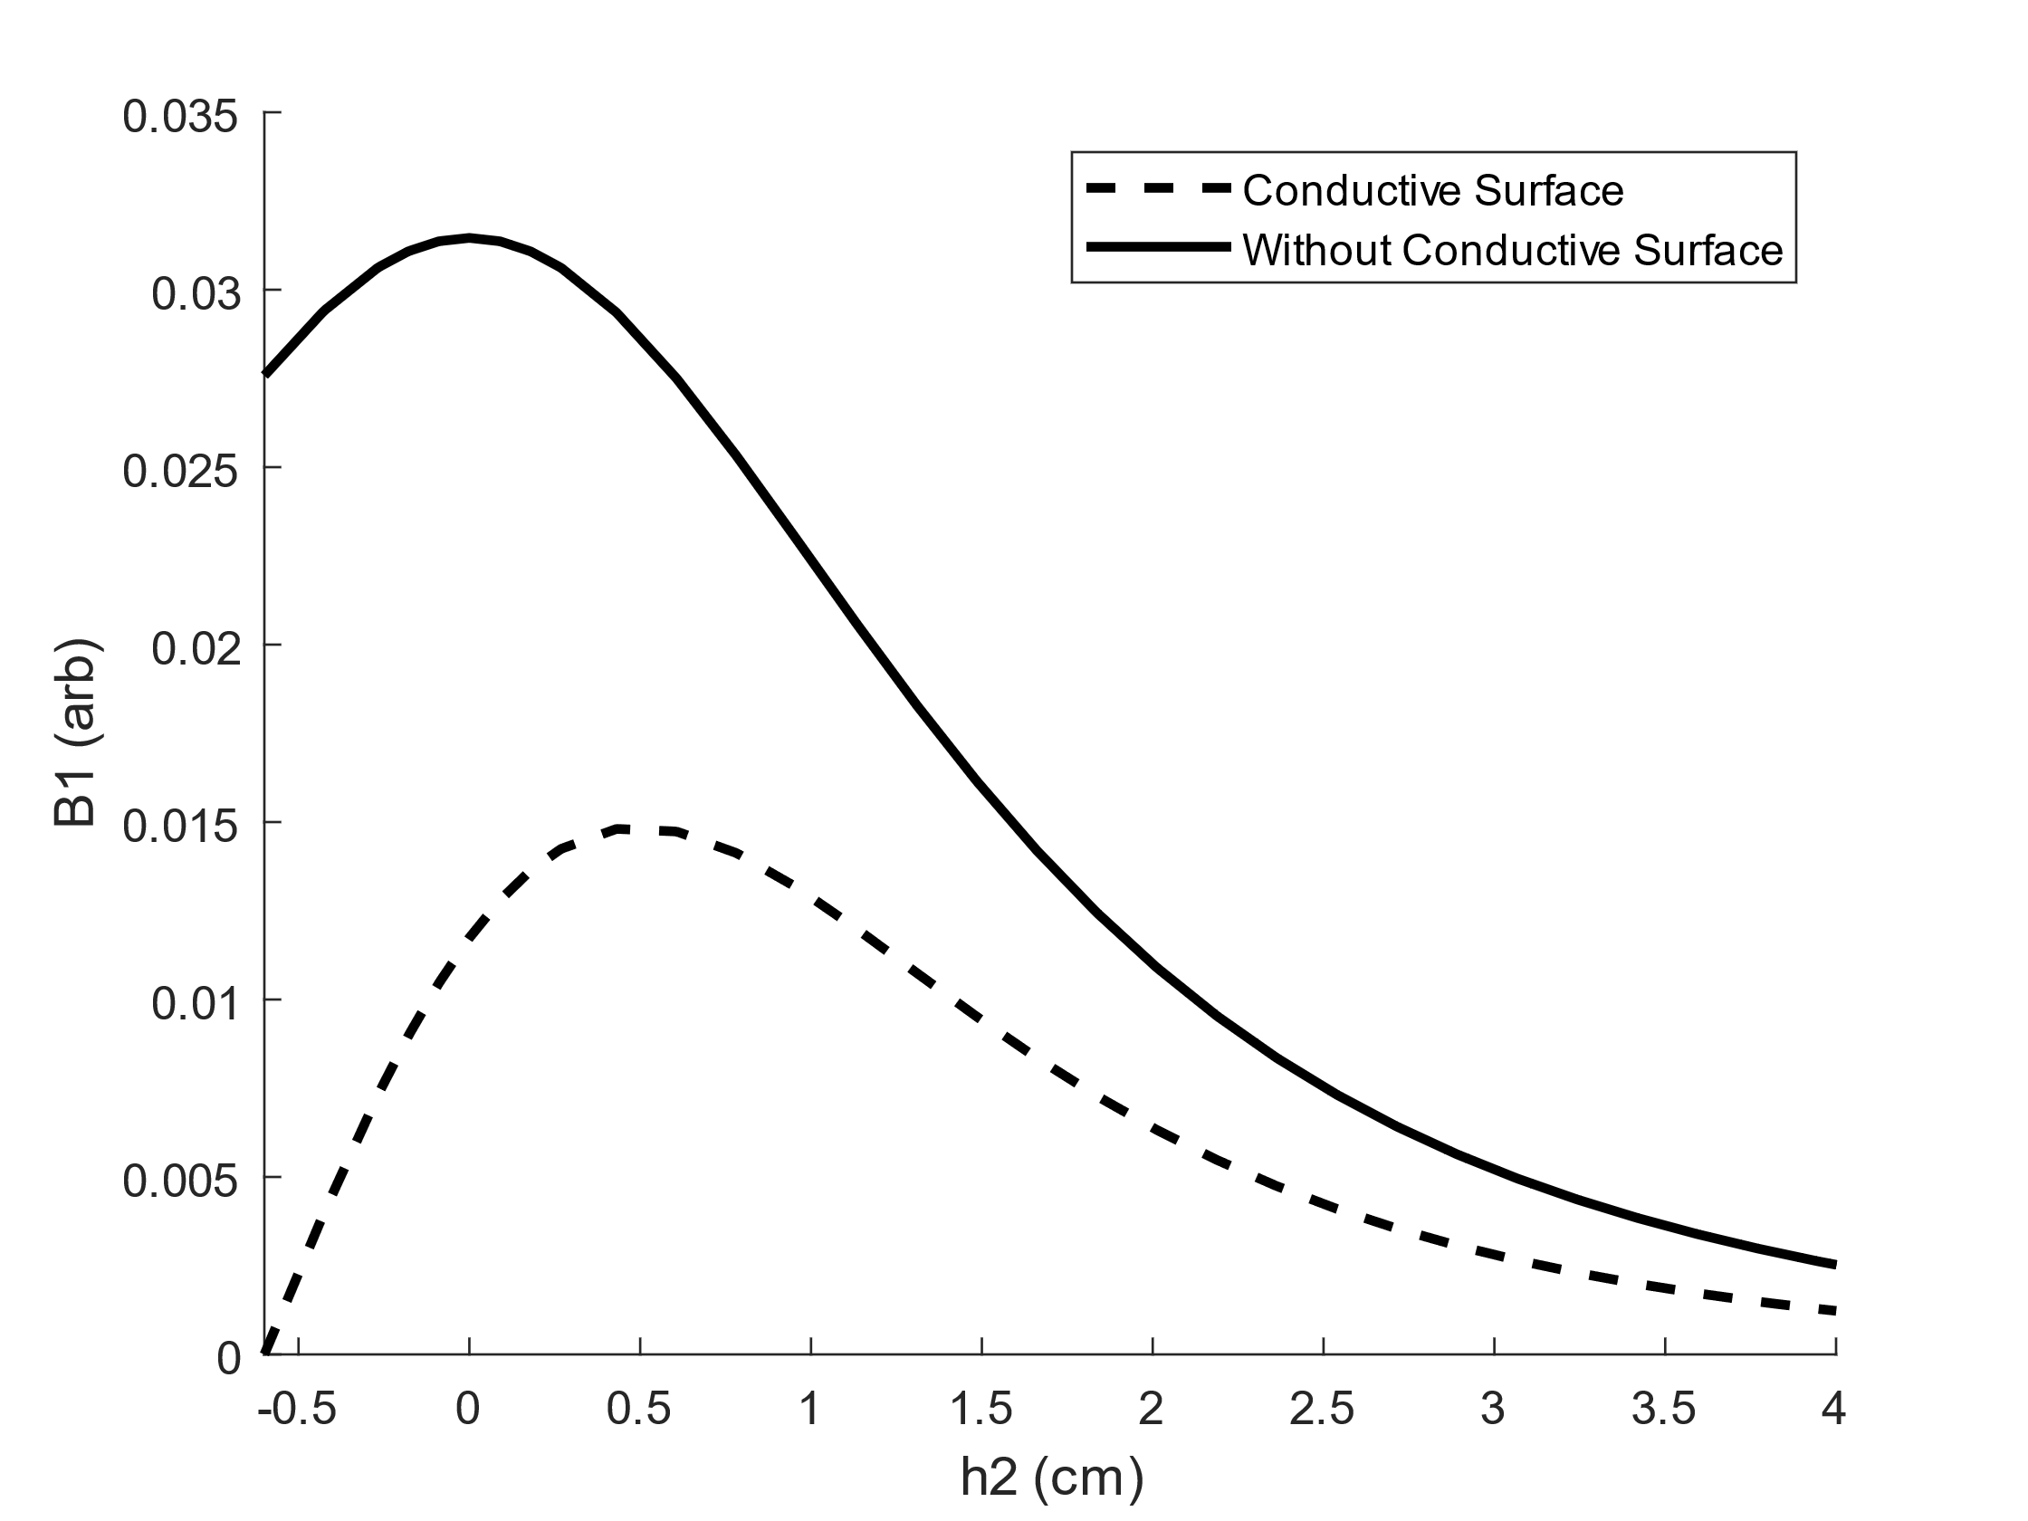
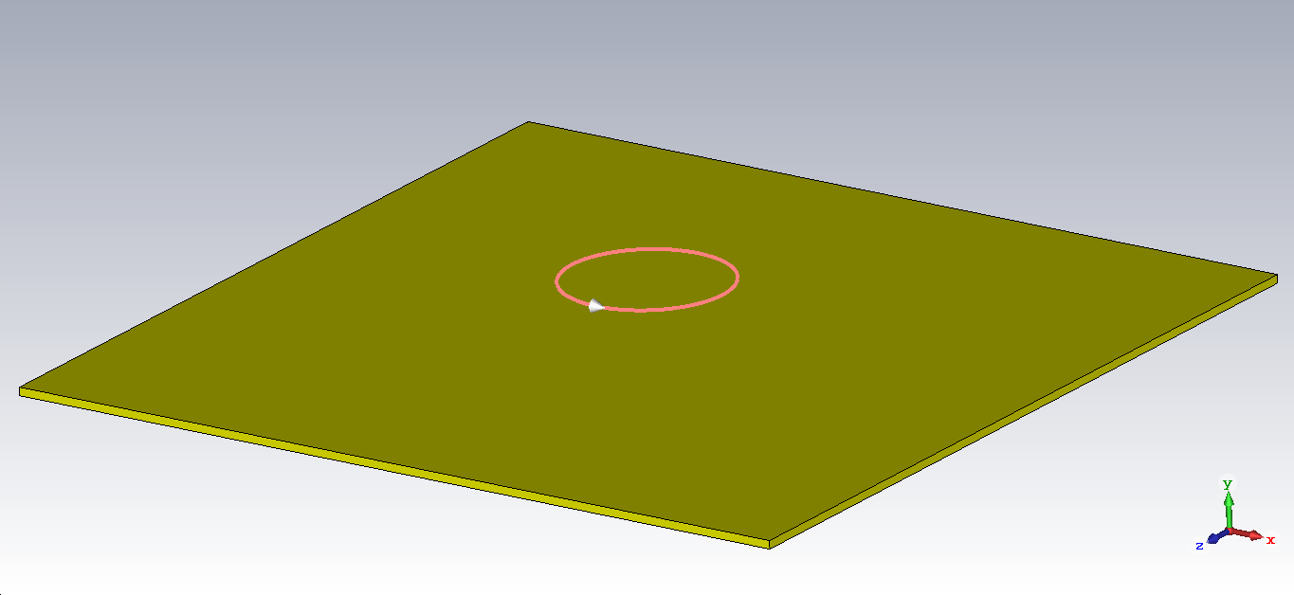
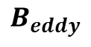
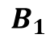
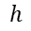
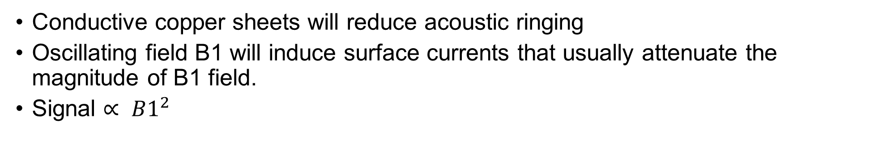
Surface Currents
Conductive copper sheets will reduce acoustic ringing
Oscillating field B1 will induce surface currents that usually attenuate the magnitude of B1 field.
Signal $∝ B1^{2}$
Nature abhors a change in flux!
$$B_{1}$$
$$h$$
$$B_{eddy}$$
Notes:
Now, surface currents are usually a big problem. They are the result of using a conductive copper sheet on the surface of our magnet. We usually use the copper sheet to eliminate acoustic ringing, which can show up as unwanted signal. Surface currents, will generally attenuate our B1 field. Since B1 squared is proportional to signal, any attenuation of B1 can be quite significant. In my example I have a loop coil with B1 pointing upwards. This B1 is oscillating up and down due to our alternating current, but let’s for a moment take a snapshot when it’s pointing upwards. We know, that nature abhors a change in flux, and thus we have eddy currents that form in our copper sheet, generating a secondary B field that opposes the direction of B1. This secondary field B_eddy, will superimpose itself on B1, ultimately attenuating the overall magnetic field. (FIGURE) In the figure I have here, we compare the magnitude of magnetic field as a function of distance from the center of the coil. The black line represents no sheet, and the dashed line represents the field when the coil is brought 0.66 cm above the sheet. We can see that with a conductive surface, the magnitude of magnetic field is greatly attenuated, by almost 50% at 1 cm above the coil.

Slide 8
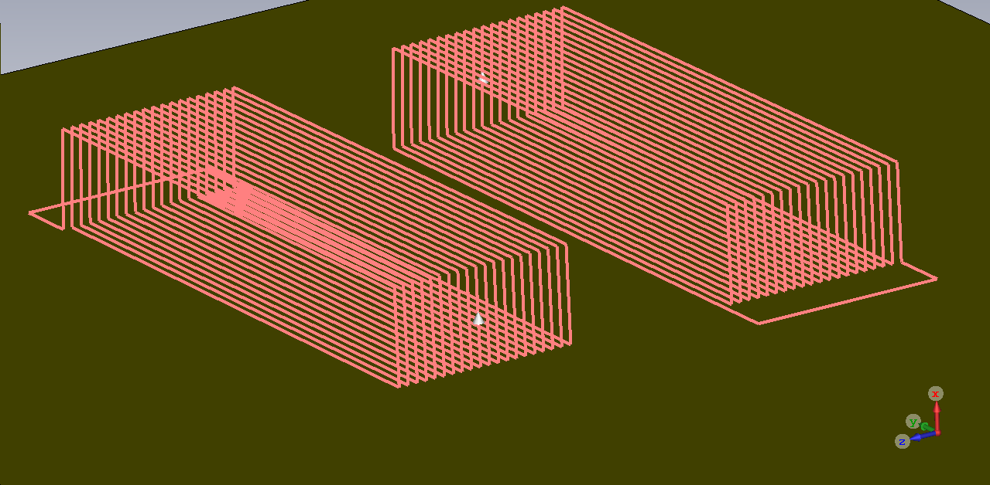
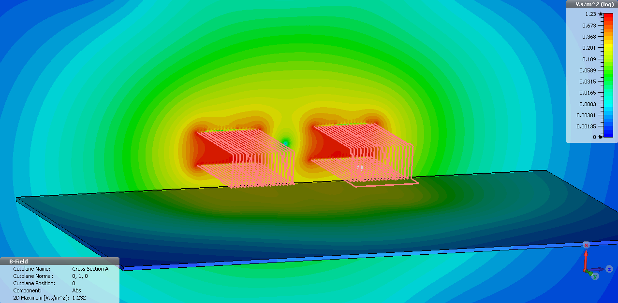
UC Davis Design
Counter-wound coil design that can use surface currents to our advantage
Utilizing the region above the center of the two coils
One wound clockwise, the other wound counter-clockwise
Notes:
In a design proposed by UC Davis, they aim to use surface currents to their advantage in a brilliant way, and this gives a perfect opportunity to use CST to verify how effective their design is.
To be brief, the design consists of two coils, one wound clockwise, and the other wound counter-clockwise which are then separated by a small distance. One would utilize the region above the center of the two coils. Now, if we can minimize the attenuation, or even use it to our advantage then that’s a really good thing. Low field is a constant fight to achieve just a bit more signal.

Slide 9
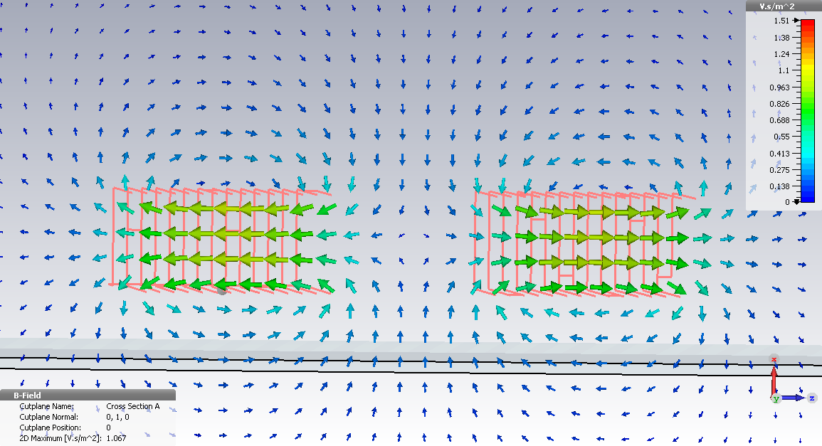
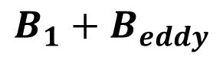
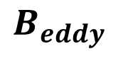
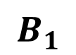
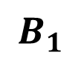
$$B_{1}$$
$$B_{1}+B_{eddy}$$
$$B_{1}$$
$$B_{eddy}$$
Notes:
To view how this works and understand what I’m trying to do while using CST to do it, I’ve taken a slice through the coil. The field lines are represented with arrows, and we can see that these two coils are counter-wound. Towards the bottom, and on the surface of our conducting sheet we have a B1 that points upwards, and towards the top we have a B1 that points downwards. The B1 that points upwards at the bottom generates eddy currents with a B_eddy that oppose the B1 field. Since we’re utilizing the B1 field above the coil, this magnetic field B_eddy superimposes itself on the field above, ultimately increasing the field rather than attenuating it.

Slide 10
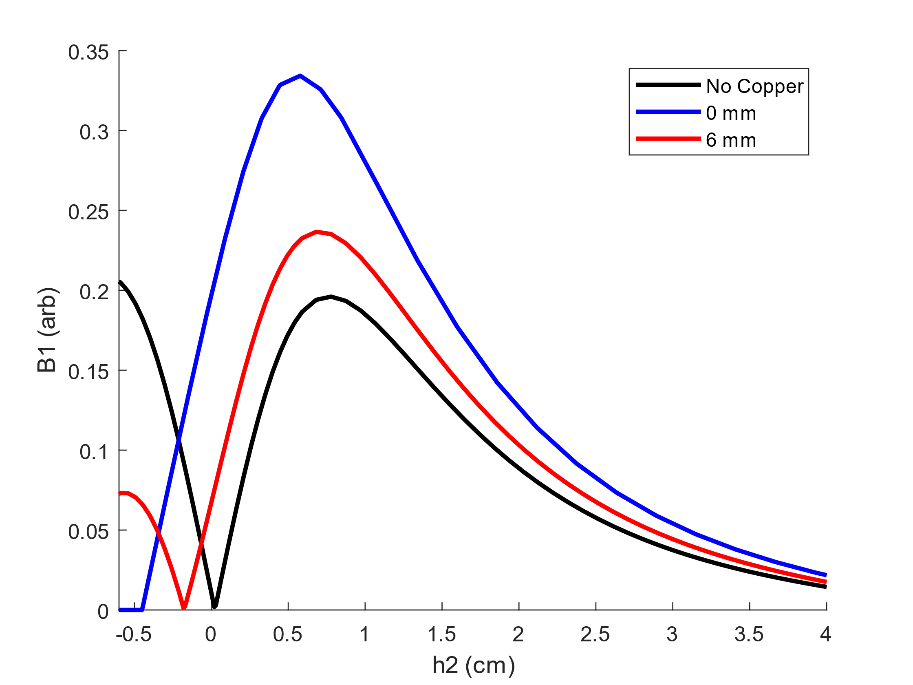
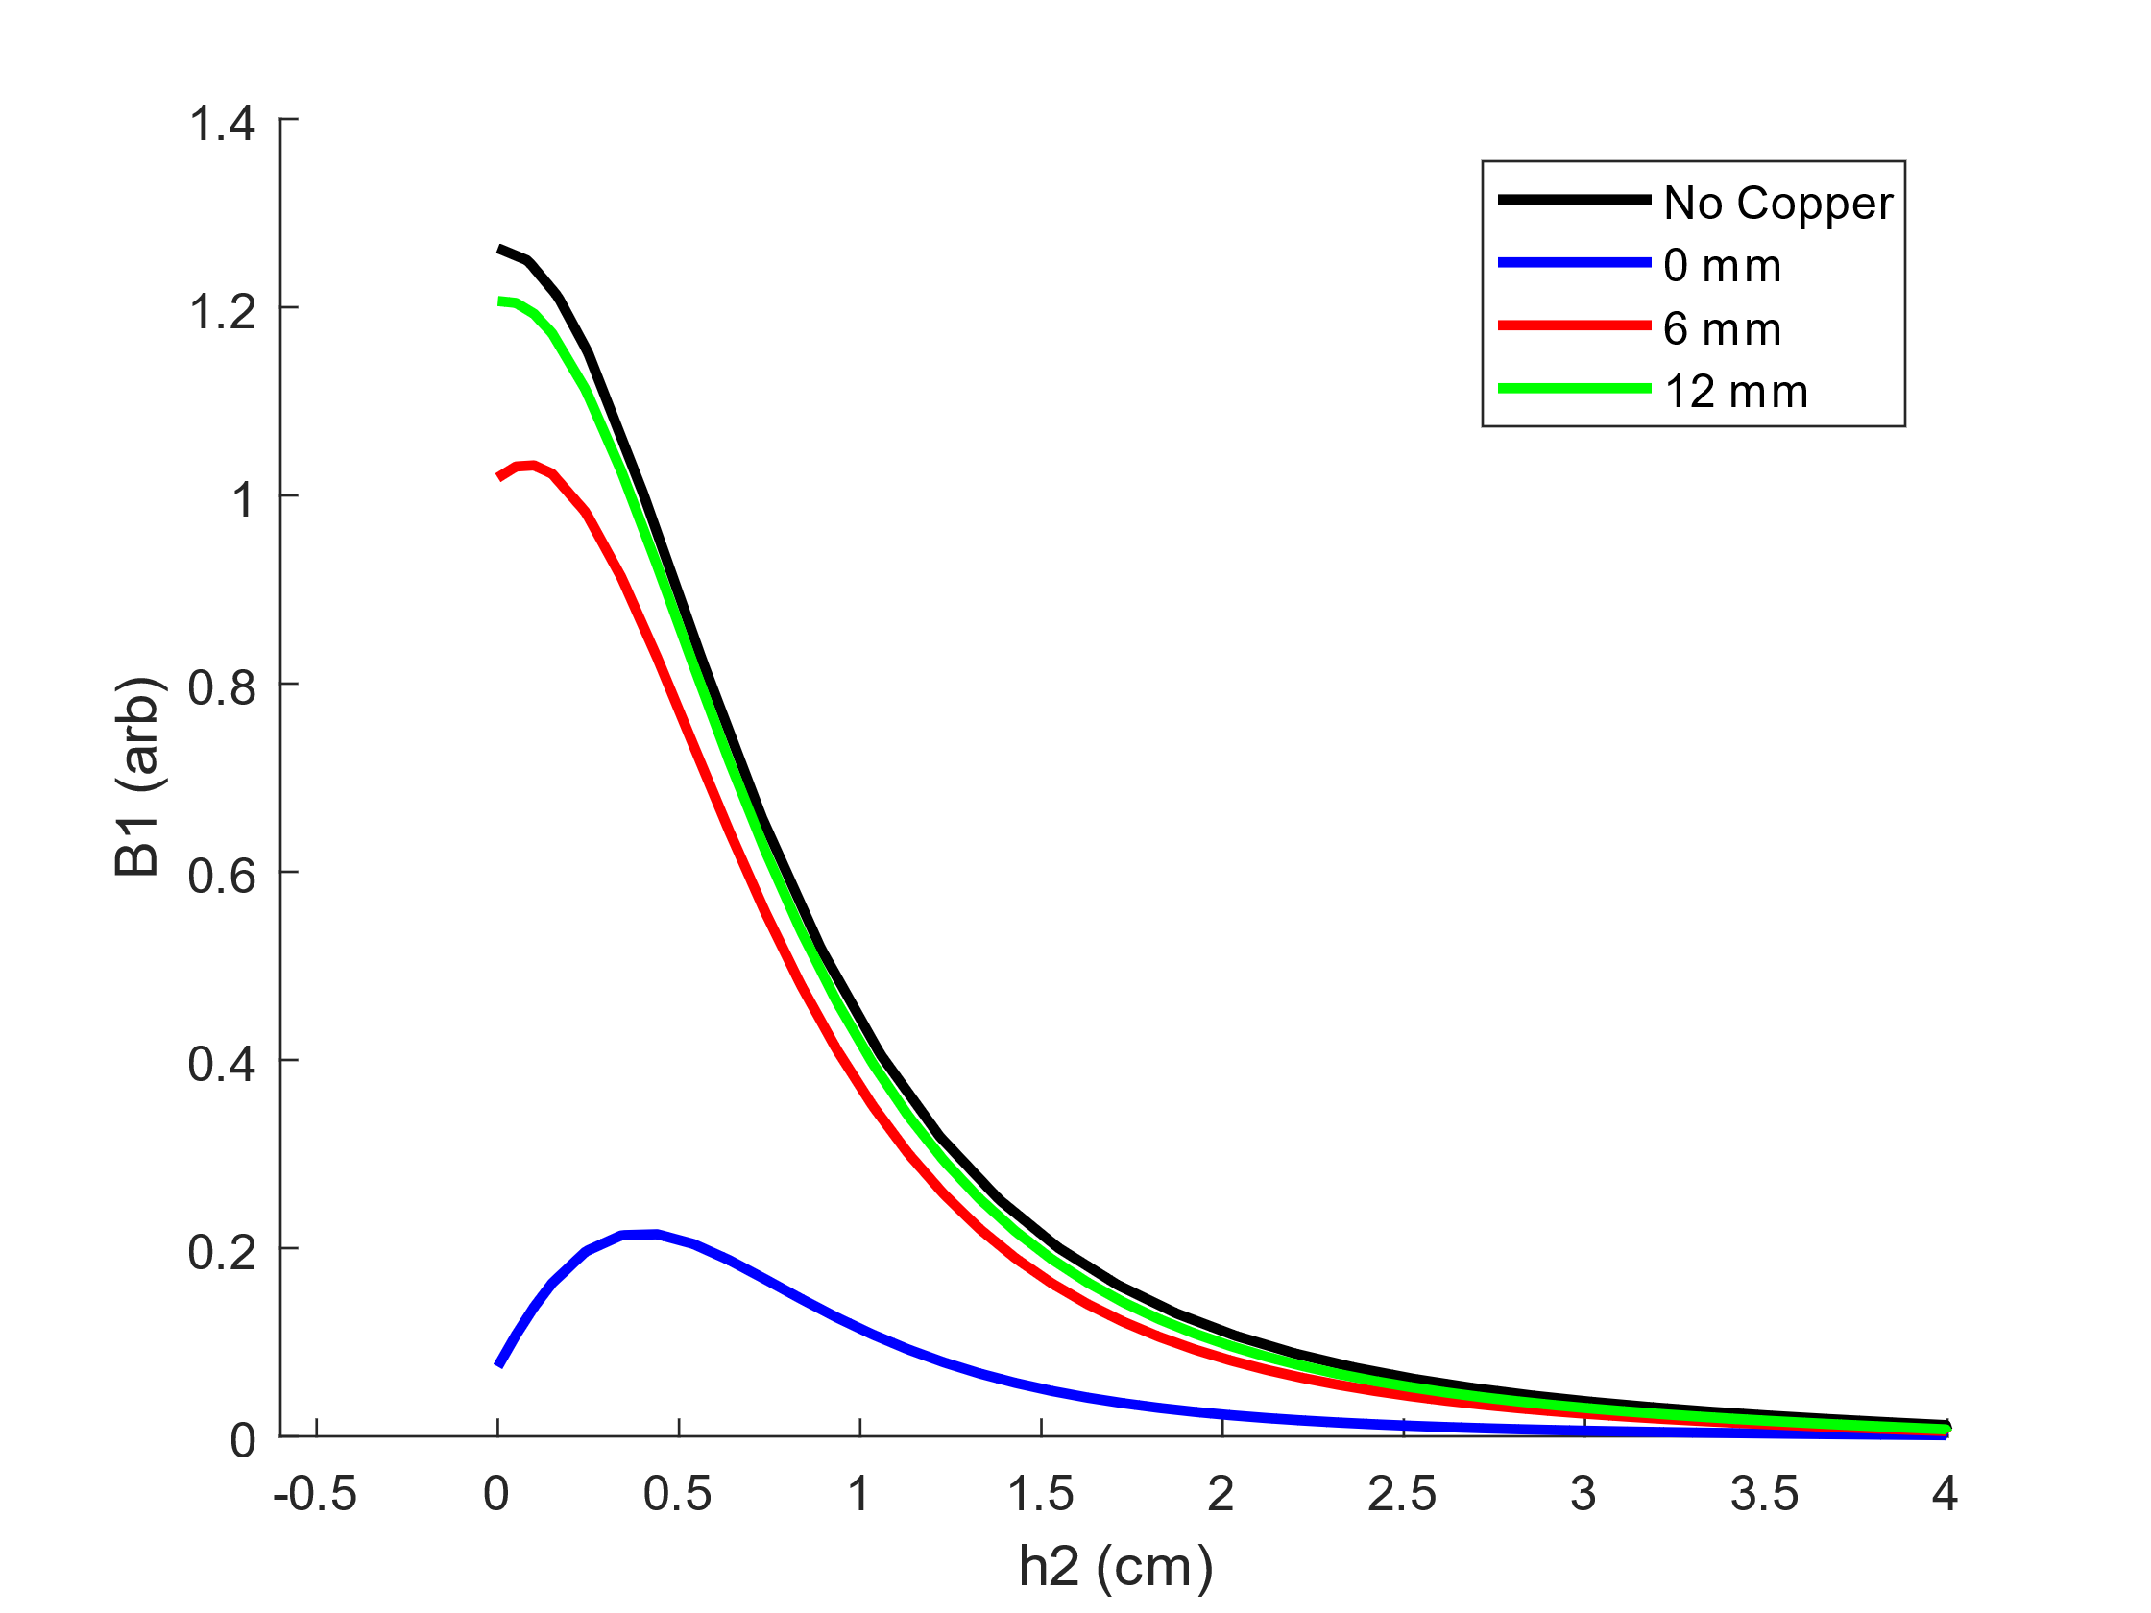
Surface Loop VS Counter-Wound
Surface Loop
Counter-Wound
B1 is amplified by surface currents
Utilizing a low field region compared to within the coil
As the coil is brought closer to the copper sheet, B1 increases.
Sample region
Best case scenario
Worst case scenario
Counter-wound design is practically equivalent to the surface loop in the worst-case scenario!
Notes:
The unfortunate part of this is that we’re utilizing an already weak part of the B1 field produced by our coil. Ideally, we’re using the region within the coil, which is going to be much stronger. Since signal is proportional to B1^2, it’s really important that we’re getting the most our coil. In the plot I have here, I’m showing magnitude of magnetic field as a function of vertical distance from the center of the coil geometry. When I say vertical distance, I’m refereeing to the line that is perpendicular to the surface of our conductive sheet. A height of 0 cm, represents the exact center of the coil geometry. We can see that as the coil gets closer to the conductive surface, the magnetic field increases. Now with a simple surface loop, we can see that as we get closer, the magnetic field drops off quickly. Worst case scenario for the surface loop, at a height of 0.5 cm the B1 reaches just above 0.2 in arbitrary units. Now, best case scenario, with the counter wound design we also get just above 0.2 in arbitrary units at a height of 0.5 cm. This shows that if there is an improvement, it may be negligible, but there may still be an improvement. I think that to say anything conclusively I’ll need to build and test the coils.

Slide 11
CST is a wonderful tool with many functionalities!
-Optimization
-Force Analysis
-3D Visualization
Homogeneous spot magnet construction
RF exploration
Conclusion
Notes:
So CST is obviously a very powerful tool. I’ve been able to apply to my research, and it’s especially been helpful when working on the unilateral magnet. It can provide a bunch of useful information, like for example the magnetostatics forces applied to each component, which can come in hand when trying to think of a design that’s appropriate for the case. I’ve also been able to look at surface currents with CST and was able to learn a lot of useful information which can hopefully be used to achieve better results. I think next on my list, is to actually build a looped surface coil and counter-wound coil in order to compare with what I’ve seen through simulation.

Slide 12

Acknowledgements
I would like to thank Bruce Balcom and Andres for all the help.
This work was supported by Mitacs through the Mitacs Research Training Award.
Notes:
And I would like to thank Bruce and Andres for helping me.

